Slide 1

Natural Language Processing
Naeemullah Khan
naeemullah.khan@kaust.edu.sa
KAUST Academy
King Abdullah University of Science and Technology

Slide 2



Traditional Language Models
Sequence
I saw the game of soccer
4.5 e-5
I saw the soccer game
6.0 e-5
J’ai vu le match de foot
I saw the soccer match
4.6 e-5
Saw I the game of soccer
2.6 e-9

Slide 3

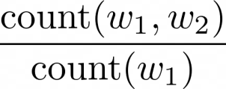

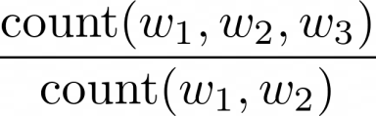

N-grams
Bigrams
Trigrams
Large N-grams to capture dependencies between distant words
Need a lot of space and RAM

Slide 4

Summary
N-grams consume a lot of memory
Different types of RNNs are the preferred alternative

Slide 5
Advantages of RNNs
Nour was supposed to study with me. I called her but sh
e did not answer
want
respond choose want have
RNNs look at every previous word
Similar probabilities with trigram
ask
attempt
answer
know

Slide 6



RNNs Basic Structure
I called her but she did not
answer
I
called
her
but
she
did not
Learnable parameters

Slide 7
Summary
RNNs model relationships among distant words
In RNNs a lot of computations share parameters

Slide 8






One to One
Real Valladolid | 0 | 1 | Real Madrid
Real Zaragoza | 0 | 4 | Real Madrid
Atletico Madrid | 0 | 1 | Real Madrid

Slide 9

One to Many
A Brown Puppy
Caption generation

Slide 10
Many to One
Sentiment analysis
Positive
Tweet:
I am very happy !

Slide 11


Many to Many
I
am
hungry
Encoder
Decoder
J’
ai
faim
Machine Translation

Slide 12

Summary
RNNs can be implemented for a variety of NLP tasks
Applications include Machine translation and caption generation

Slide 13

Math in Simple RNNs
How RNNs propagate information (Through time!)
How RNNs make predictions

Slide 14











A Vanilla RNN
...

Slide 15




A Vanilla RNN
+

Slide 16



Summary
Hidden states propagate information through time
Basic recurrent units have two inputs at each time:
,

Slide 17



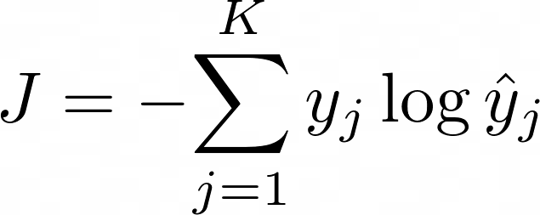








Cross Entropy Loss
K - classes or possibilities
Either 0 or 1
Looking at a single example

Slide 18
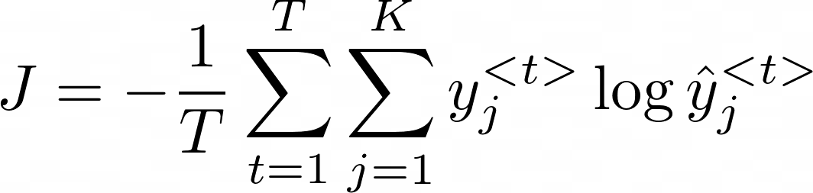

Cross Entropy Loss for RNNs
...
Average with respect to time
For RNNs the loss function is just an average through time!

Slide 19

Gated Recurrent Unit (GRU)
Gated recurrent unit (GRU) structure
Comparison between GRUs and vanilla RNNs

Slide 20
Gated Recurrent Units
“Ants are really interesting. They are everywhere.”
Plural
Relevance and update gates to remember important prior information

Slide 21






Gated Recurrent Unit
Gates to keep/update relevant information in the hidden state
x
1
+
-
x
x
Hidden state candidate
tanh

Slide 22




Vanilla RNN vs GRUs
x
1
+
-
x
x
tanh

Slide 23

Summary
GRUs “decide” how to update the hidden state
GRUs help preserve important information

Slide 24
Deep and Bi- directional RNNs
deeplearning.ai

Slide 25

Deep and Bi- directional RNNs
How bidirectional RNNs propagate information
Forward propagation in deep RNNs

Slide 26
Bi-directional RNNs
I was trying really hard to get a hold of
. Louise, finally
her him them
answered when I was about to give up.
...

Slide 27

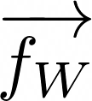



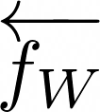




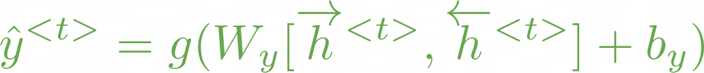
Bi-directional RNNs
..
.
..
.
Information flows from the past and from the future
independently

Slide 28











Deep RNNs
...
Intermediate layers and activations
...
...
...
...
Get hidden states for current layer
Pass the activations to the next layer

Slide 29

Summary
In bidirectional RNNs, the outputs take information from the past and
the future
Deep RNNs have more than one layer, which helps in complex tasks

Slide 30

RNNs and Vanishing Gradients
Backprop through time
RNNs and vanishing/exploding gradients
Solutions

Slide 31
RNNs: Advantages
Captures dependencies within a short range
Takes up less RAM than other n-gram models

Slide 32
RNNs: Disadvantages
Struggles to capture long term dependencies
Prone to vanishing or exploding gradients

Slide 33


RNN Basic Structure
goal
She kicked the ball right into the
She
kicked
the
ball
right
into the
Learnable parameters

Slide 34

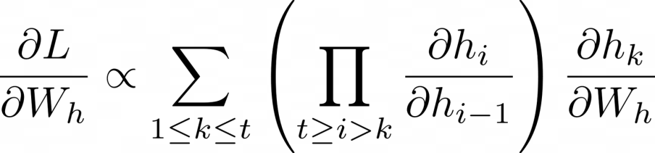
Backpropagation through time
Same at every step
Gradient is proportional to a sum of
partial derivative products

Slide 35
Backpropagation through time
Contribution of hidden state k
Length of the product proportional to
how far k is from t
Contribution of hidden state t-10

Slide 36
Backpropagation through time
Contribution of hidden state k
Length of the product proportional to
how far k is from t
Contribution goes to 0 Contribution goes to
Partial derivatives <1
Vanishing Gradient
Partial derivatives >1
infinity
Exploding Gradient

Slide 37
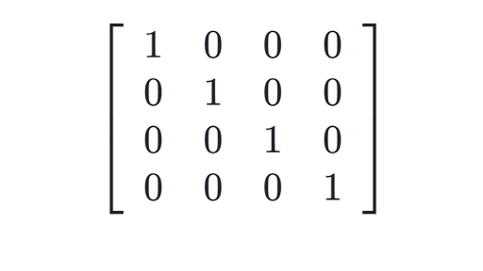



Solving for vanishing or exploding gradients
Identity RNN with ReLU activation
Gradient clipping
Skip connections

Slide 38

LSTMs
Meet the Long short-term memory unit!
LSTM architecture
Applications

Slide 39
LSTMs: a memorable solution
Learns when to remember and when to forget
Basic anatomy:
A cell state
A hidden state
Multiple gates
Gates allow gradients to avoid vanishing and exploding

Slide 40

LSTMs: Based on previous understanding
Starting point with some irrelevant information
Cell and Hidden States
Discard anything irrelevant
Add important new information Produce output
Gates

Slide 41










Gates in LSTM
Output
Cell state
Forget Gate: information that is no longer important
Input Gate: information
to be stored
Output Gate: information to use at current step
x +
tanh
x _{x}
1 2 3
tanh
LSTM Unit
Hidden state
Input

Slide 42





Applications of LSTMs
Next-character Chatbots
prediction
Music
composition
Image
captioning
Speech recognition

Slide 43


Summary
LSTMs offer a solution to vanishing gradients
Typical LSTMs have a cell and three gates:
Forget gate
Input gate
Output gate

Slide 44

Gates in LSTM
Output
1. Forget Gate: information that is no longer important
Cell state
x +
tanh
x _{x}
1 2 3
_{e} tanh
2. Input Gate: information
to be stored
LSTM Unit
3. Output Gate: information to use at current step
Hidden stat
Sigmoid output between 0 and 1
0-Closed 1-Open
Input

Slide 45

Candidate Cell State
Output
Cell state
x +
tanh
x _{x}
tanh
Candidate cell state
Information from the previous hidden state and current input
Hidden state
tanh
Tanh Shrinks argument to be
Other activations could be
used
Input
between -1 and 1

Slide 46
New Cell State
Output
Cell state
x +
tanh
x _{x}
tanh
New Cell state
Add information from the candidate cell state using the forget and input gates
Hidden state
tanh
Input

Slide 47
New Hidden State
Output
Cell state
x +
tanh
x _{x}
tanh
New Hidden State
Select information from the new cell state using the output gate
Hidden state
tanh
Input
The Tanh activation could be
omitted

Slide 48
Summary
LSTMs use a series of gates to decide which information to keep:
Forget gate decides what to keep
Input gate decides what to add
Output gate decides what the next hidden state will be

Slide 49
References
These slides have been adapted from
Younes Mourri & Lukasz Kaiser, Natural Language Processcing Specialization, DeepLearning.Ai

